Slide 1

PG Diploma in Big Data Analytics(PG-DBDA)
Linux Programming and Cloud Computing

Slide 2
Linux Programming
Linux History and Operation
Installing and Configuring Linux (Ubuntu and CentOS)
Basic Commands
Gaining confidence with Linux
Vi/vim/gedit editior
Linux shell programming
Git / GitHub
Reference Books:
1. Linux: The Complete Reference – Petersen/ TMH 6 th Edition
2. The Linux Programming Interface: Linux and UNIX System Programming Handbook
3. Pro Bash Programming: Scripting the GNU/Linux Shell, Second Edition
4. Beginning Unix – Joe Marilino (Wrox Publication)
5. Linux Command Line and Shell Scripting Bible – Blum (Wiley – India)

Slide 3
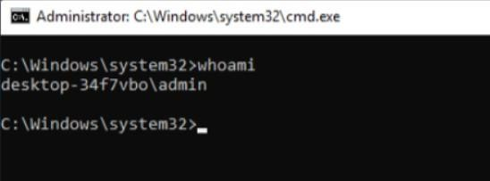
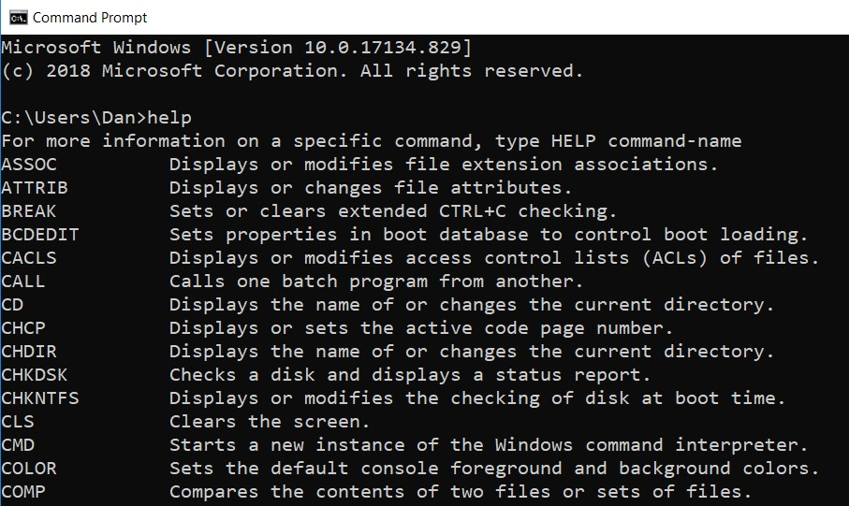
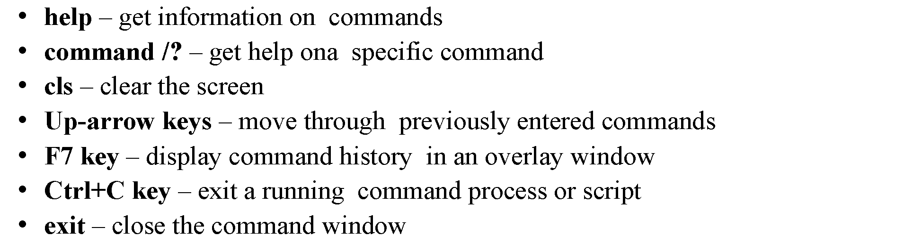
Windows Basic Commands
Notes:
Color 1f

Slide 4
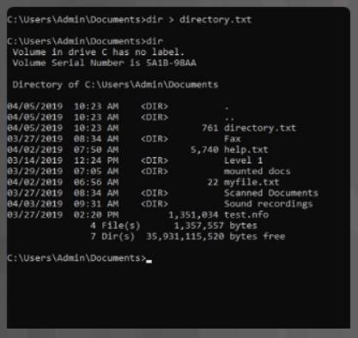
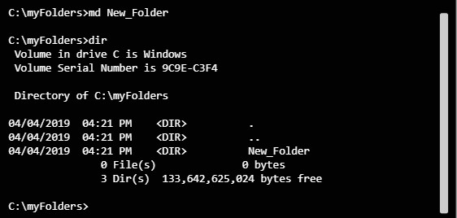
md – make directory. Create a new directory
rd – remove directory. Delete a directory
move – move a file or directory from one directory to another
ren – rename a directory or file
type – display the contents of a file
more – display the contents of a file one screen at a time
del – delete a file or folder
copy – make a copy of a file
move – move a file from a source location to a destination location

Slide 5
Operating Systems and Linux
An operating system is a program that manages computer hardware and software for the user.
Operating systems were originally designed to perform repetitive hardware tasks, managing files, running programs, and receiving commands from the user.
File management, program management, and user interaction are traditional features common to all operating systems.
Linux, like all versions of Unix, adds two more features. Linux is a multiuser and multitasking system

Slide 6
History of Unix and Linux
Unix
In 1969, Ken Thompson, Dennis Ritchie, and the researchers at AT&T Bell Laboratories developed the Unix operating system, incorporating many of the features of the MULTICS research project.
Linux
Originally designed specifically for Intel-based PCs, Linux started out at the University of Helsinki as a personal project of a computer science student named Linus Torvalds
Students were making use of a program called Minix, which highlighted different Unix features.
Minix was created by Professor Andrew Tanenbaum and widely distributed over the Internet to students around the world.
Linus’s intention was to create an effective PC version of Unix for Minix users.
It was named Linux, and in 1991, Linus released version 0.11.

Slide 7
Linux History and Operation
Linux can be generally divided into three major components: the kernel, the environment, and the file structure.
The kernel is the core program that runs programs and manages hardware devices, such as disks and printers.
The environment provides an interface for the user. It receives commands from the user and sends those commands to the kernel for execution.
The file structure organizes the way files are stored on a storage device, such as a disk. Files are organized into directories.
Together, the kernel, the environment, and the file structure form the basic operating system structure. With these three, you can run programs, manage files, and interact with the system.

Slide 8
Advantages of Linux
Linux is an open-source operating system like Windows and MacOS. It is not just limited to the operating system, but nowadays, it is also used as a platform to run desktops, servers, and embedded systems. It provides various distributions and variations as it is open source and has a modular design. The kernel is a core part of the Linux system.
Linux system is used to manage various services such as process scheduling, application scheduling, basic peripheral devices, file system, and more.
Open Source
Security
Free
Performance
Software Updates
Distributions/ Distros
Graphical User Interface
Networking
Multitasking

Slide 9
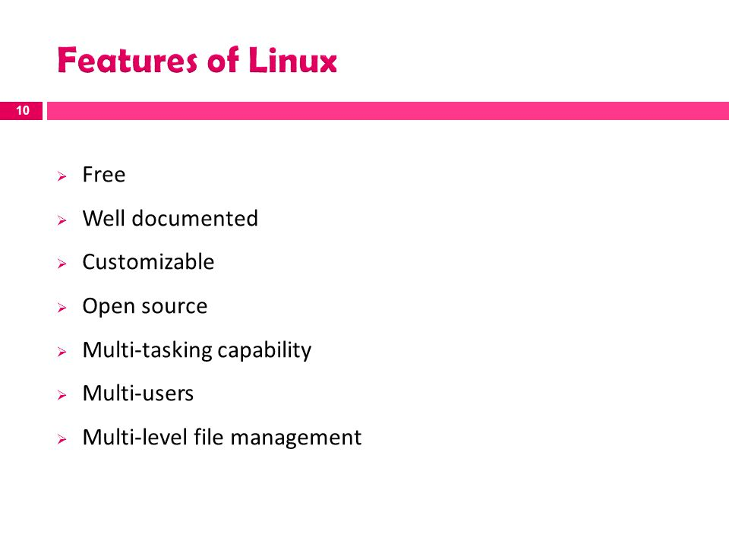

Slide 10
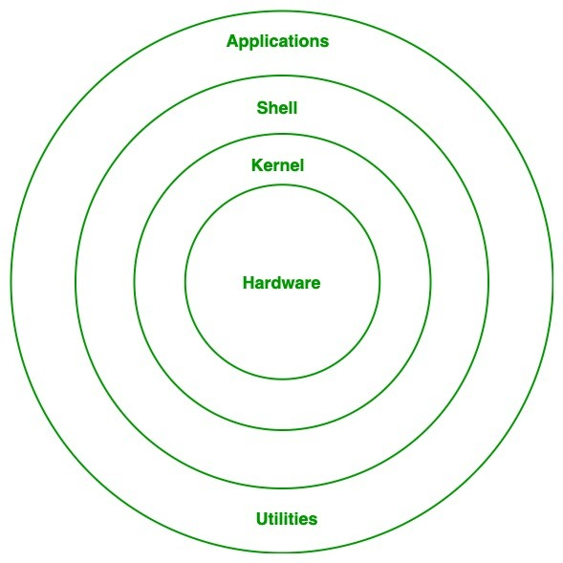
Architecture of Linux
HARDWARE: physical parts of a computer, such as central processing unit (CPU), monitor, mouse, keyboard, hard disk and other connected devices to CPU.
KERNEL: A kernel is a computer program and is the central, core part of an operating system. It manages the operations of the computer and the hardware, most notably memory and CPU time. It is an integral part of any operating system.
SHELL: Shell is an environment in which we can run our commands, programs, and shell scripts. It is a user interface for access to an operating system's services.
Application programs/software An application, or application program, is a software program that runs on your computer. It is excited by user. Some inbuilt application programs in Linux are terminal, Firefox browser, Libre office

Slide 11
The GNU Movement and the GPL
GNU stands for Gnu's Not Unix, and it is pronounced as “g-noo”.
GNU is a free and open-source operating system that was started in 1984 by Richard Stallman. GNU is based on the Unix operating system, but it has been greatly modified over the years.
GNU make sure that any software source code licensed under it have to make originating source code open and freely available to all its users. Here, freely doesn't mean by cost but it means that it is freely available to users to distribute and modify the code.
lists terms and conditions for copying, modifying and distributing free software-a series of widely used free software licenses that guarantee end users

Slide 12
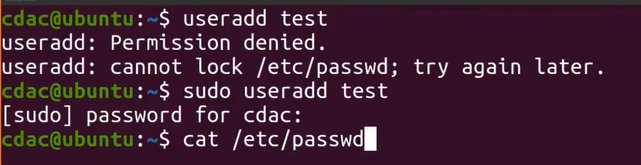
User add & passwd
The $ is the prompt for regular users, whereas the # is the prompt solely for the root user.
Add by using privileges of super user

Slide 13
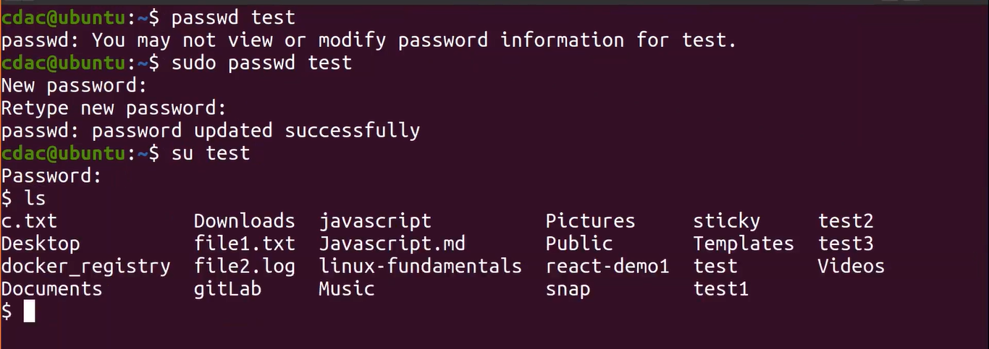
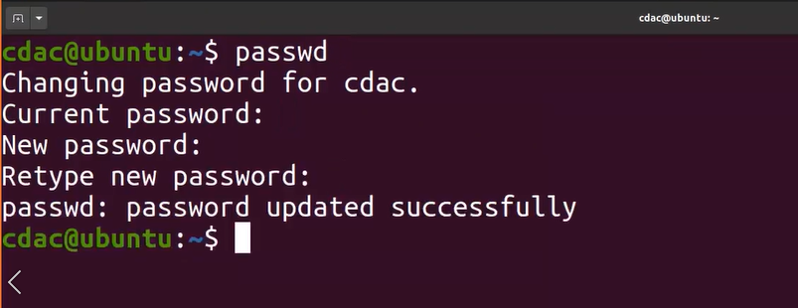
Update passwd

Slide 14
Installing apps using apt is as easy as:
$ sudo apt install app_name
Uninstalling an app via apt is also super easy:
$ sudo apt remove app_name
To upgrade your installed apps, you'll first need to update the app repository:
$ sudo apt update
Once finished, you can update any apps that need updating with the following:
$ sudo apt upgrade
$ sudo apt update app_name

Slide 15
Logging In and Out with the Command Line
Once you log in to an account, you can enter and execute commands. Logging in to your Linux account involves two steps: entering your username and then entering your password.
To end your session, issue the logout or exit command.
[$ logout or exit
If you want to turn off your computer, you must first shut down Linux.
halt
Alternatively, you can use the shutdown command with the -h option
# shutdown -h now

Slide 16

SSH
SSH which stands for Secure Shell, It is used to connect to a remote computer securely.
Compare to Telnet, SSH is secure wherein the client /server connection is authenticated using a digital certificate and passwords are encrypted.
Hence it’s widely used by system administrators to control remote Linux servers. Once you are logged in, you can execute any commands that you do in your terminal
SSH username@ip-address or hostname

Slide 17
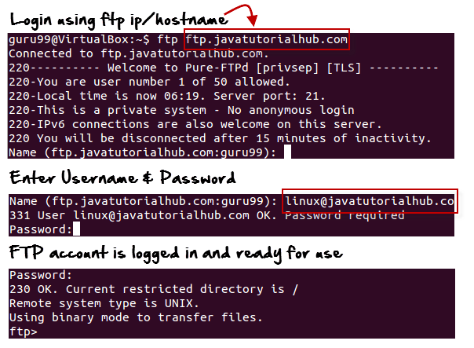
FTP
FTP is file transfer protocol. It’s the most preferred protocol for data transfer amongst computers.
You can use FTP to –
Logging in and establishing a connection with a remote host
Upload and download files
Navigating through directories
Browsing contents of the directories
ftp hostname="" or=""

Slide 18
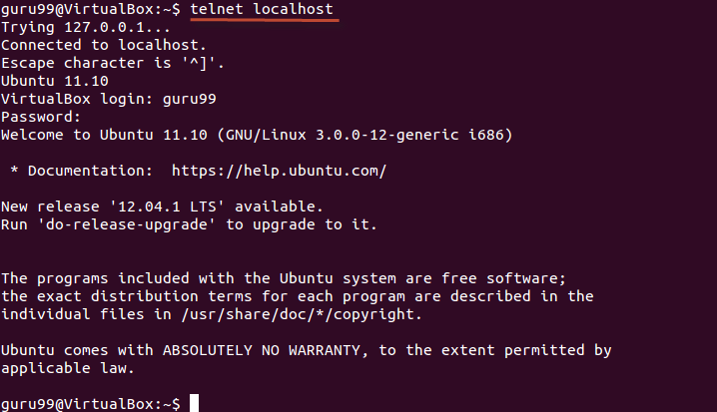
Telnet
Telnet helps to –
connect to a remote Linux computer
run programs remotely and conduct administration

Slide 19
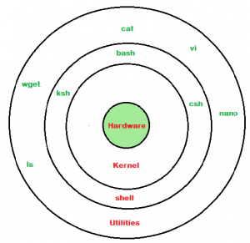
Linux shell programming
What is Shell?
A shell is a special user program that provides an interface for the user to use operating system services.
Shell accepts human-readable commands from users and converts them into something which the kernel can understand.

Slide 20
Shell is broadly classified into two categories –
Command Line Shell
Graphical shell
There are several shells are available for Linux systems like –
BASH (Bourne Again SHell) – It is the most widely used shell in Linux systems. It is used as default login shell in Linux systems and in macOS. It can also be installed on Windows OS.
CSH (C SHell) – The C shell’s syntax and its usage are very similar to the C programming language.
KSH (Korn SHell) – The Korn Shell was also the base for the POSIX Shell standard specifications etc.(POSIX Shell is a command line shell for computer operating system which was introduced by IEEE Computer Society. POSIX stands for Portable Operating System Interface.)
Each shell does the same job but understands different commands and provides different built-in functions.

Slide 21
Why do we need shell scripts?
There are many reasons to write shell scripts:
To avoid repetitive work and automation
System admins use shell scripting for routine backups.
System monitoring
Adding new functionality to the shell etc.

Slide 22
Some Advantages of shell scripts
The command and syntax are exactly the same as those directly entered in the command line, so programmers do not need to switch to entirely different syntax
Writing shell scripts are much quicker
Quick start
Interactive debugging etc.
Some Disadvantages of shell scripts
Prone to costly errors, a single mistake can change the command which might be harmful.
Slow execution speed
Design flaws within the language syntax or implementation
Not well suited for large and complex task etc

Slide 23
Create a file using a vi editor (or any other editor). Name script file with extension .sh.
Start the script with #! /bin/sh.
Write some code.
Save the script file as filename.sh.
For executing the script type bash filename.sh.

Slide 24
Creating a Shell Script
touch script.sh
chmod +x script.sh
nano script.sh
Add the following commands to test this shell script
echo This is my first shell script
touch testfile
ls
echo End of my shell script
Save the changes, and run the shell script by typing in
./script.sh

Slide 25
Variables in Shell Script
There are two types of variables:
System Defined variables
User-Defined Variables.
System-defined variables, also called environment variables, are generally Capitalised.
You can view all the current environment variables using the printenv command.
User-Defined variables are set by the user, and they exist only during script execution.
You can define a variable by simply typing its name and assigning a value with = sign and access a variable by adding a $ before the variable name.

Slide 26
# Accessing an Environment Variable
echo $USER
# Creating and accessing User defined Variable
variable_name="Geeksforgeeks"
echo $variable_name

Slide 27
There are many Shells available in Linux, such as The bourne shell(sh), The Korn Shell(ksh), and GNU Bourne-Again Shell(bash).
Scripts written for the sh shell are called shell scripts.
To do this, add “#!” on top of the script file, followed by the absolute path of the shell of choice.
#!/bin/bash
This line is called the shebang line.
.

Slide 28
Comparison Operators
Integer comparison
Operator | Description
-eq | is equal to
-ne | is not equal to
-gt | is greater than
-ge | is greater than or equal to
-lt | is less than
-le | is less than or equal to
Operator Description
== is equal to
!= is not equal to
\< is less than, in ASCII alphabetical order
\> is greater than, in ASCII alphabetical order

Slide 29
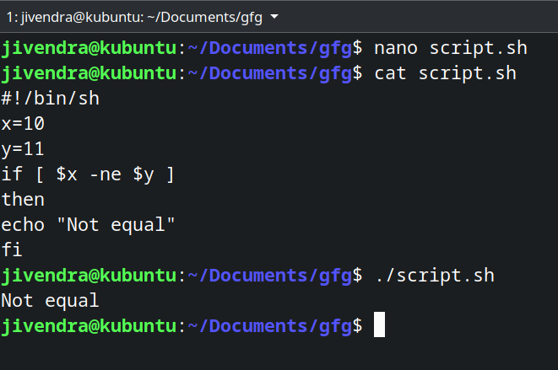
Conditional statements
Conditional statements are used to execute a block of code only when certain conditions are met. Shell scripts support the use of conditional statements. We use comparison operators to check the conditions.
Syntax
if [ condition ]
then #statements
Fi
Let’s see an example.
#!/bin/sh
x=10
y=11
if [ $x -ne $y ]
Then
echo "Not equal“
fi

Slide 30
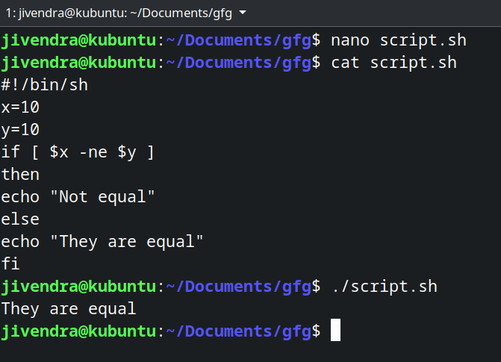
if-else statement
In an if-else statement,
you can specify a set of commands to run if the condition is not met.
Syntax
if [ condition ]
then #set of statements if the condition is true
else #set of statements if the condition is false
fi

Slide 31
if..then..else..if..then..fi..fi..(Nested if)
Nested if-else block can be used when, one condition is satisfies then it again checks another condition.
In the syntax,
if expression1 is false then it processes else part, and again expression2 will be check.
Syntax:
if [ expression1 ]
then statement1
statement2 .
else if [ expression2 ]
then statement3
fi

Slide 32
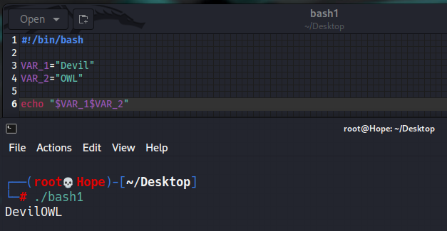
Shell Scripting – Shell Variables
It must be noted that no other special character except underscore can be used in a variable name because all other special characters have special meanings in Shell Scripting.
A variable name could contain any alphabet (a-z, A-Z), any digits (0-9), and an underscore ( _ ). However, a variable name must start with an alphabet or underscore. It can never start with a number.
Variable data could be accessed by appending the variable name with ‘$’ as follows:
Accessing variable
#!/bin/bash
VAR_1="Devil"
VAR_2="OWL"
echo "$VAR_1$VAR_2“
Output:
DevilOWL

Slide 33
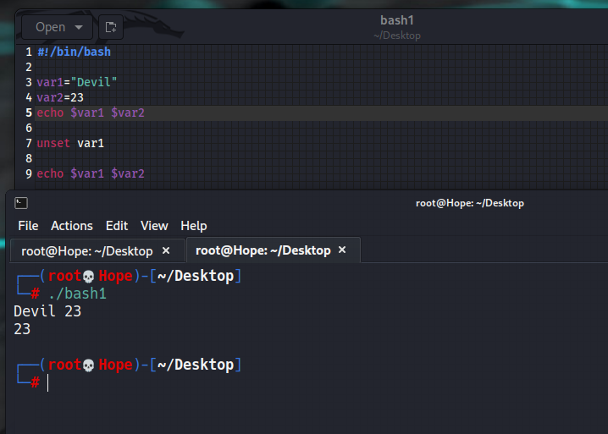
Unsetting Variables
The unset command directs a shell to delete a variable and its stored data from list of variables.

Slide 34
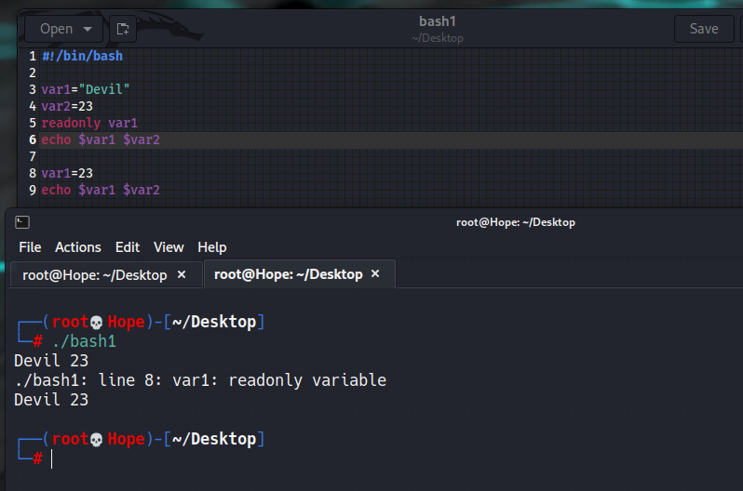
Read only Variables. These variables are read only i.e., their values could not be modified later in the script.

Slide 35
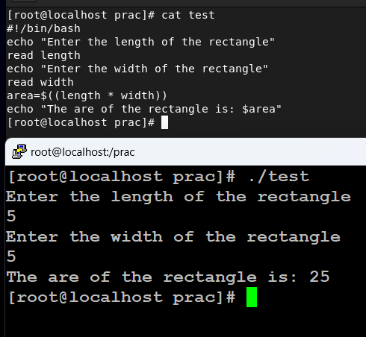
Read and echo commands in shell scripts
How to Store User Data in a Variable?
#!/bin/bash
echo "Enter the length of the rectangle"
read length
echo "Enter the width of the rectangle"
read width
area=$((length * width))
echo "The are of the rectangle is: $area"
In this example the variables ‘length’, ‘width’ and ‘area’ are used to store user input and calculate the area of the rectangle.

Slide 36
Arithmetic in shell scripts
#!/bin/bash
x=8
y=2
echo "x=8, y=2"
echo "Addition of x & y"
echo $(( $x + $y ))
echo "Subtraction of x & y"
echo $(( $x - $y ))
echo "Multiplication of x & y"
echo $(( $x * $y ))
echo "Division of x by y"
echo $(( $x / $y ))

Slide 37
Looping Statements | Shell Script
Looping Statements in Shell Scripting: There are total 3 looping statements that can be used in bash programming
while statement
for statement
until statement
while statement

